Slide 1

W2: Clients & contracting
Client-Consultant Relationships
Notes:
Already last week, we discussed what consulting means - and how consultants work with clients. We said that this relationship can sometimes be fraught - communication is not easy, and expectations might differ. This week we're exploring how consulting relationships actually work: the gap between what firms say these relationships are and what they turn out to be in practice.

Slide 2
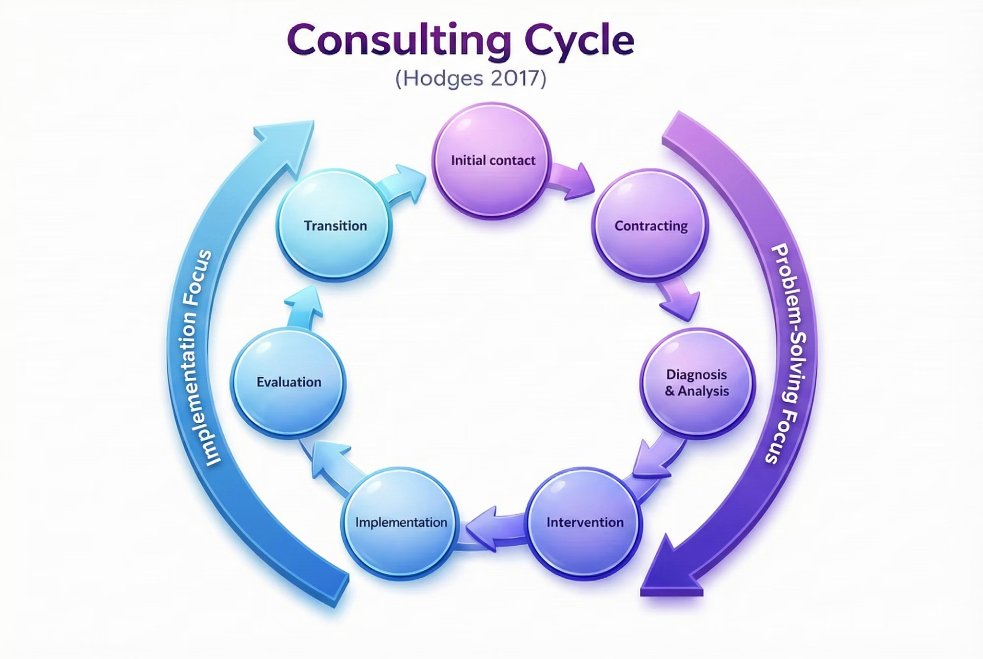

The Consultancy Cycle: Where It All Begins
Contracting isn't just about getting a signature on a document.
The relationship is set before the work begins. Pay attention to how it's being framed from day one.

Slide 3

The Partnership Rhetoric
"We put ourselves in our clients' shoes and measure our success against their expectations." (PwC)
"We partner with clients to help them innovate more sustainably, achieve lasting gains in performance, and build workforces that will thrive for this generation and the next." (McKinsey)
When have you experienced a professional relationship that genuinely matched such rhetoric?
Does the partnership framing hold up in practice? Does it align with the incentives of all parties (orgs and individuals)?
Notes:
Notice the language: partnership, collaboration, walking in their shoes, measuring against expectations. It sounds warm, almost intimate.

Slide 4





How Academic Literature Frames Consultants
Outsiders
Knowledge Entrepreneurs
Bringing fresh perspectives unburdened by organisational history
Developing "ambiguous, yet attractive products"
Legitimisers
Heroes
Providing external validation for decisions already made
Rescuing struggling organisations from crisis
Does this framing overstate consultants' influence? Can consultants do things to passive clients?
Notes:
Generally very individualistic framing – need to think about action *in a system*

Slide 5


Sturdy: Reality Is More Complex
Clients are "highly active" participants who adapt consultant advice like "recipes from cookbooks to suit their own tastes." (cf Sturdy, 2018)
In practice:
You deliver a recommendation
The client doesn't just accept or reject it: they reshape it
They blend it with their own ideas, filter it through their politics
They (might) implement something that's partly yours and partly theirs
Also: boundaries blur.
The moment you walk through the door, you become an organisational actor. You're inside, not outside … with all the opportunities and complications that brings.
Notes:
You work alongside client staff for months. Personal relationships develop. You become embedded in the organisation's dynamics.

Slide 6



Relationship Management Priorities
Karantinou and Hogg (2001) studied what makes consulting relationships difficult - with links to Week 1.
Information Asymmetry
Ambiguous Power
Value Conflicts
You know your methods and expertise;
they know their organisation.
Who's actually in charge?
E.g., you prioritise efficiency and speed; they prioritise avoiding risks and consensus.
Build Trust
Maintain Distance
Trust is essential for influence and access to information
Independence preserves your outsider perspective and objectivity
Consultancy becomes "personified", i.e., clients purchase “knowledge and creativity embodied in individuals” (Halinen, 1997, p. 28)
Notes:
“Client” holds the power – in theory – but does that mean a “lowly” client contact holds power over a senior consultant?
Get too close and you lose your outsider perspective—you become captured by the client's way of seeing things. Stay too distant and you can't build the trust needed to influence anything. Especially when you don't come from a top brand - but even there - clients need to buy you - but should also be able to hand over, so that perspectives can remain fresh and development continue

Slide 7




RECALL
Remember the Four Roles
Plumber
Doctor
Advisor
Navigator
Expert pair of hands to execute something already decided
Diagnose the problem properly before prescribing solutions
Strategic partner helping client think through options
Guide change through complex organisational terrain
The Misalignment Problem
The Solution
Imagine you walk in thinking you're a Doctor; they see you as a Plumber. Conflict is likely.
Clarify roles early and explicitly.
E.g., ask: "What do you see as my role in this?"
Notes:
Doctor - asks questions that will be seen as second-guessing clients' competence.

Slide 8


Who's Got the Monkey? (Oncken & Wass, 1974)
01
Client describes a problem
…. often with complexity and urgency
02
You say "let me think about that"
You now have the monkey. The client waits and is dependent on you.
03
You're the one who must act next
Sometimes that's right. But some monkeys are theirs to keep.
Pay attention to monkey movement. When someone hands you a monkey, ask: should this monkey be with me, or should it stay with them? If you accumulate all the monkeys, you become the blocker!
Image credit: alumroot on Flickr
Notes:
Coaches do not take monkeys - and that is always a part of the relationship, especially as a navigator.

Slide 9
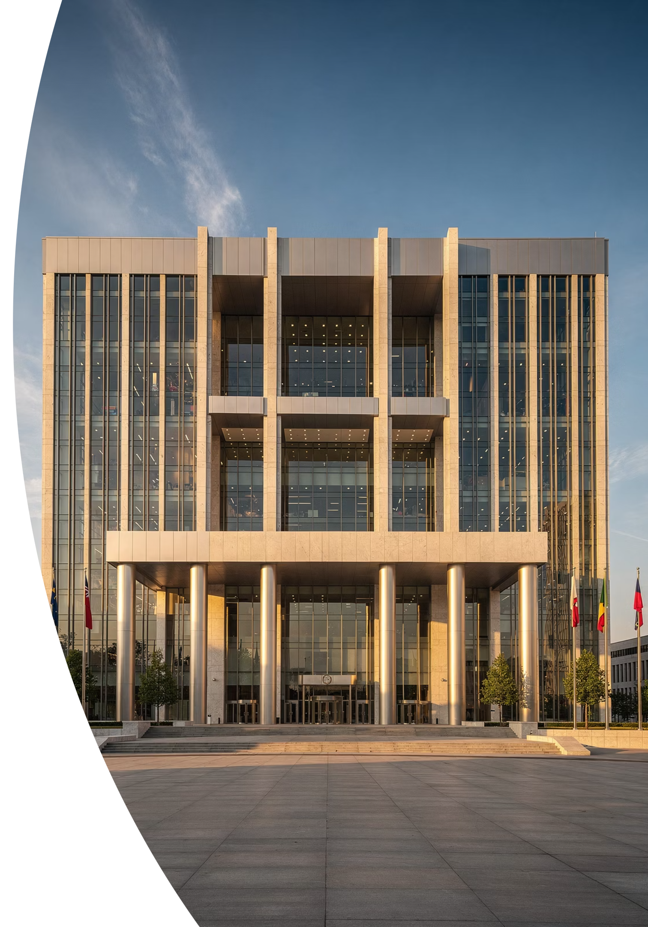

Different Contexts: Public Sector
Radnor and O'Mahoney (2013) examined consulting in the public sector (a growth sector)
1
Lower Familiarity
Public sector clients are often less familiar with process management approaches & consultancy jargon
2
Higher Risk Aversion
Given the political consequences of visible failures and stricter rules
3
Procurement Dominance
Pushes toward standardised, comparable products and price sensitivity, rather than bespoke solutions
Different values?
Understand your client's world: their constraints, their culture, their language, their definition of success.
An NHS trust isn't Goldman Sachs
A local council isn't a tech startup

Slide 10

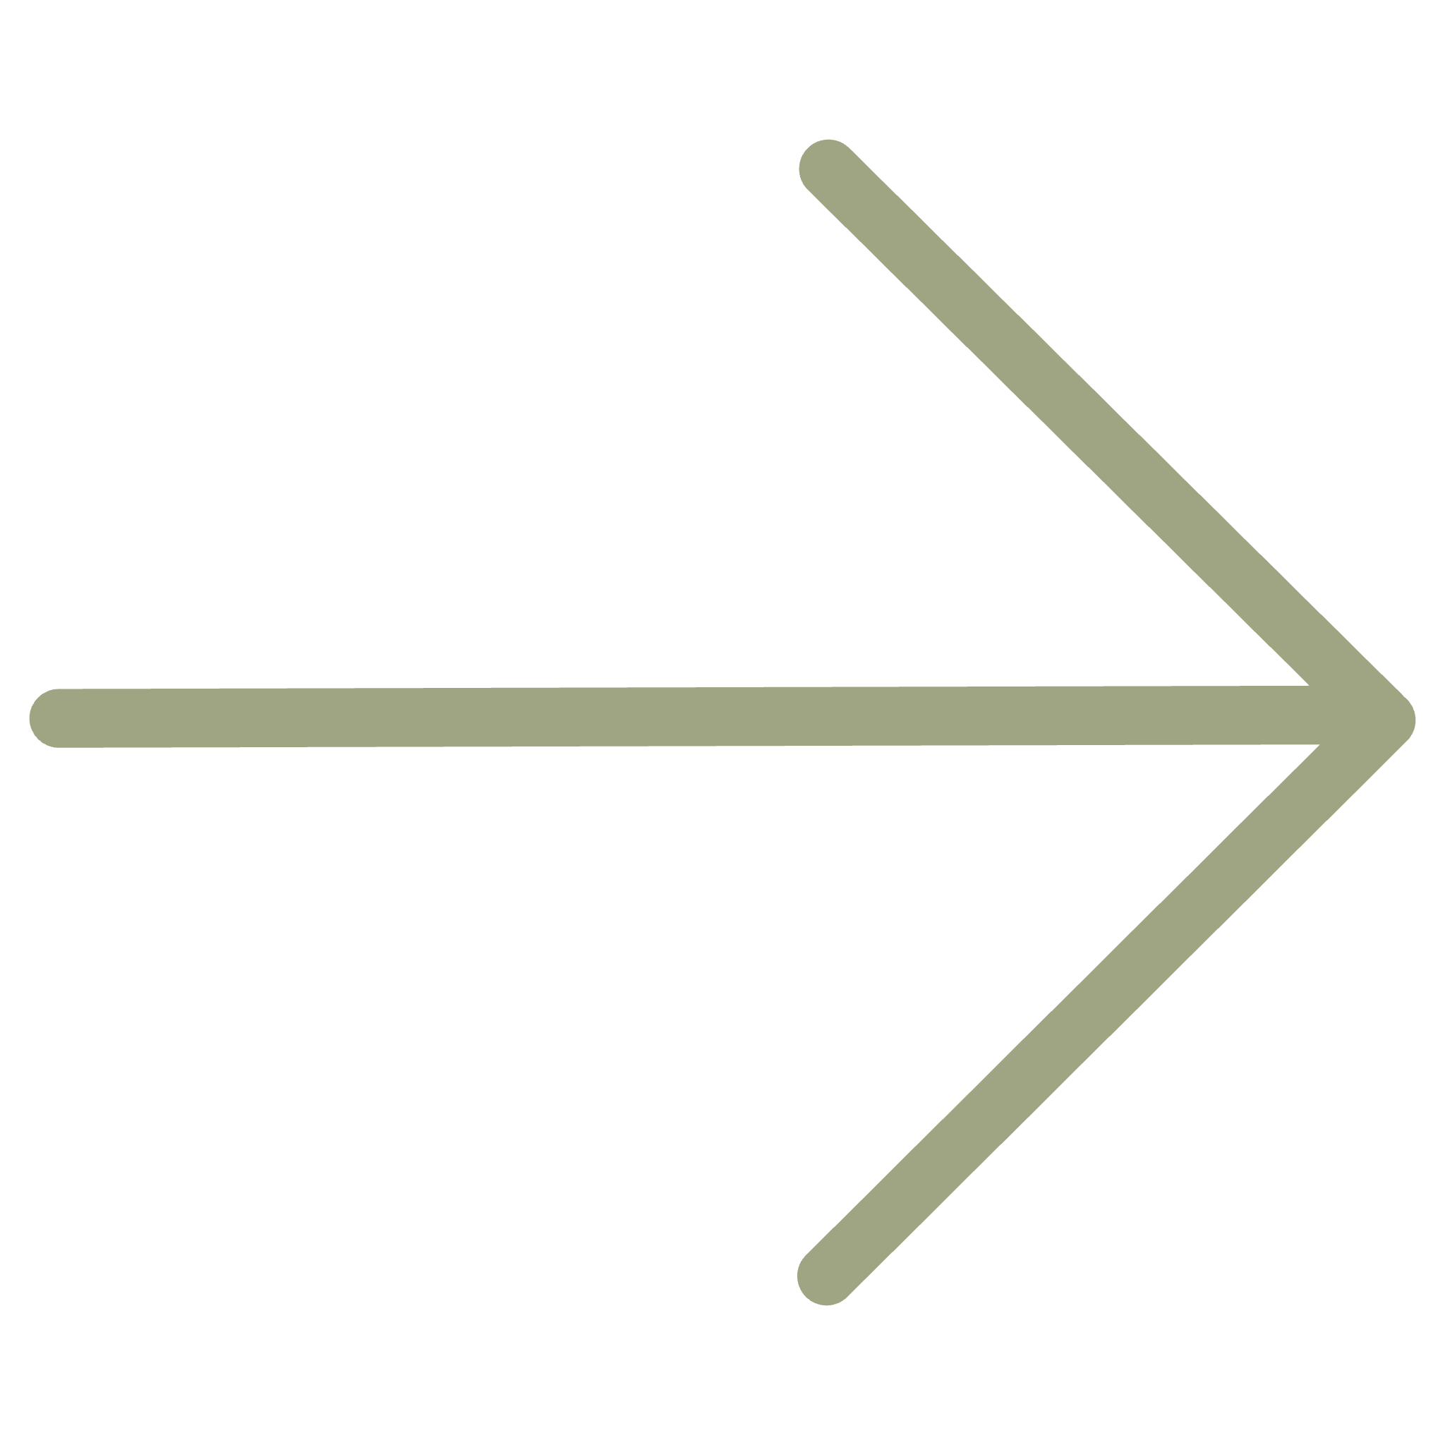
Your reflection
Before moving on, think about a professional relationship where the other party didn't understand your context—your constraints, your pressures. How did that affect the dynamic?
COMING UP NEXT
To build a relationship, we need a client.
Notes:
It's not always "client has problem, calls consultant." Sometimes consultants create the problem. We'll look at farming versus hunting, and a framework called the Pyramid of Trust.

